Slide 1
<A Quiz App For WINdows>
<Rahul Verma>

Slide 2
<Requirement Analysis>
<Purpose>
{Providing a compact windows app to manage and implement Quiz. }
<Scope 1>
<Scope 2>
{ Can also be used for organisation, institutions, academics purpose. }
{ The main idea for the app is to manage competitive exam with ease. }

Slide 3
<Some random Information>
What is the name of this app?
RVQ .
What features does it provide?
It provides a sign-up and login Panel for Student;
It also provides a sign up panel and login panel for admin ;
Also provides a panel to edit the database of the app for an Admin User;
It provides a quiz app for time boundation set by the Developer for Student;
And then all depends to your curiosity to discover and recommendations to consider;
Our team is working on it and keep fine-tuning it.;

Slide 4
Preview database Table
Sign-up Page
Add a new Question
Starting page
Admin Sign-Up
Edit a Question
Login Page
Delete A Question
Student Sign-Up
About Page
Attempt the quiz within Time Boundation
Help Page

Slide 5
<Motivation && Advantages>
Pen Paper quiz require transportation cost, printing cost, checking cost RVQ app frees you from such over expenditure. ;
It Reduces Wastage of Paper And thus is Eco friendly. ;
Checking Time ,Transportation time is reduced, ;
Students Can Check their Result immediately. ;

Slide 6
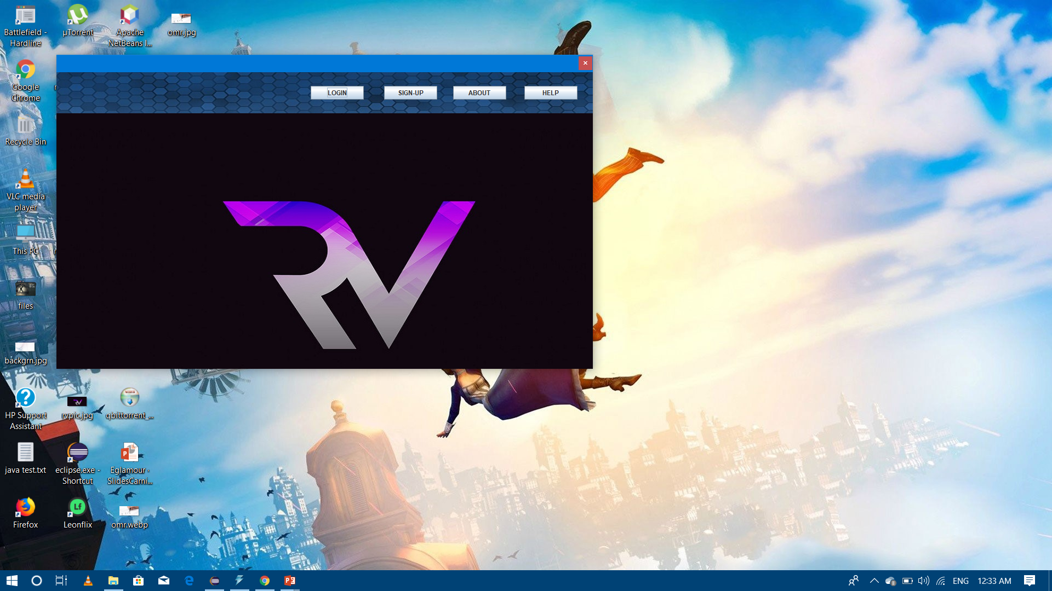
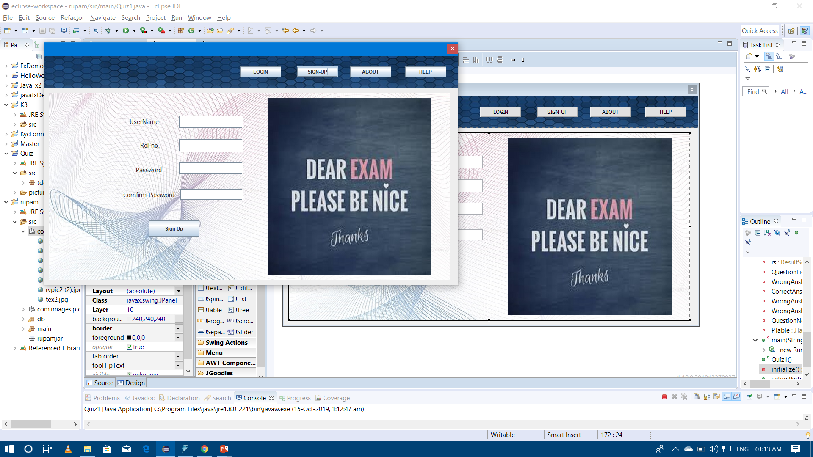
<Snap Shots>
<Login Page>
<Starting Screen>

Slide 7
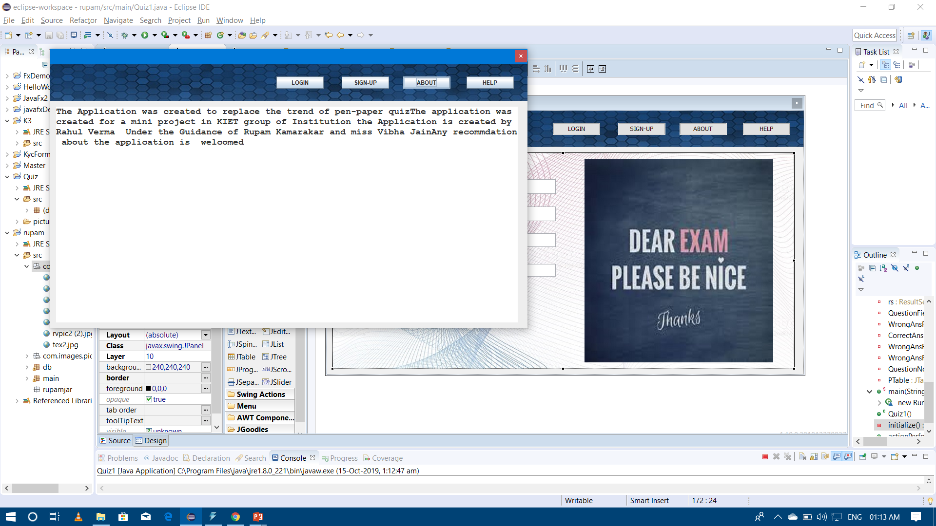
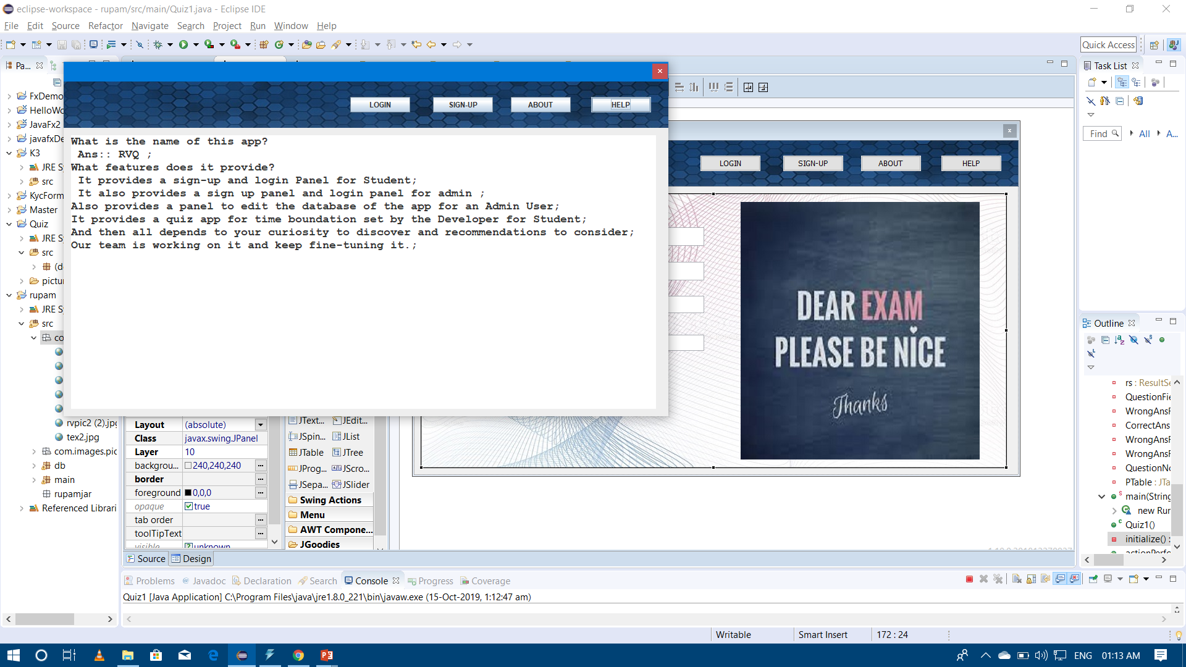
<About Panel> <Help Panel>

Slide 8
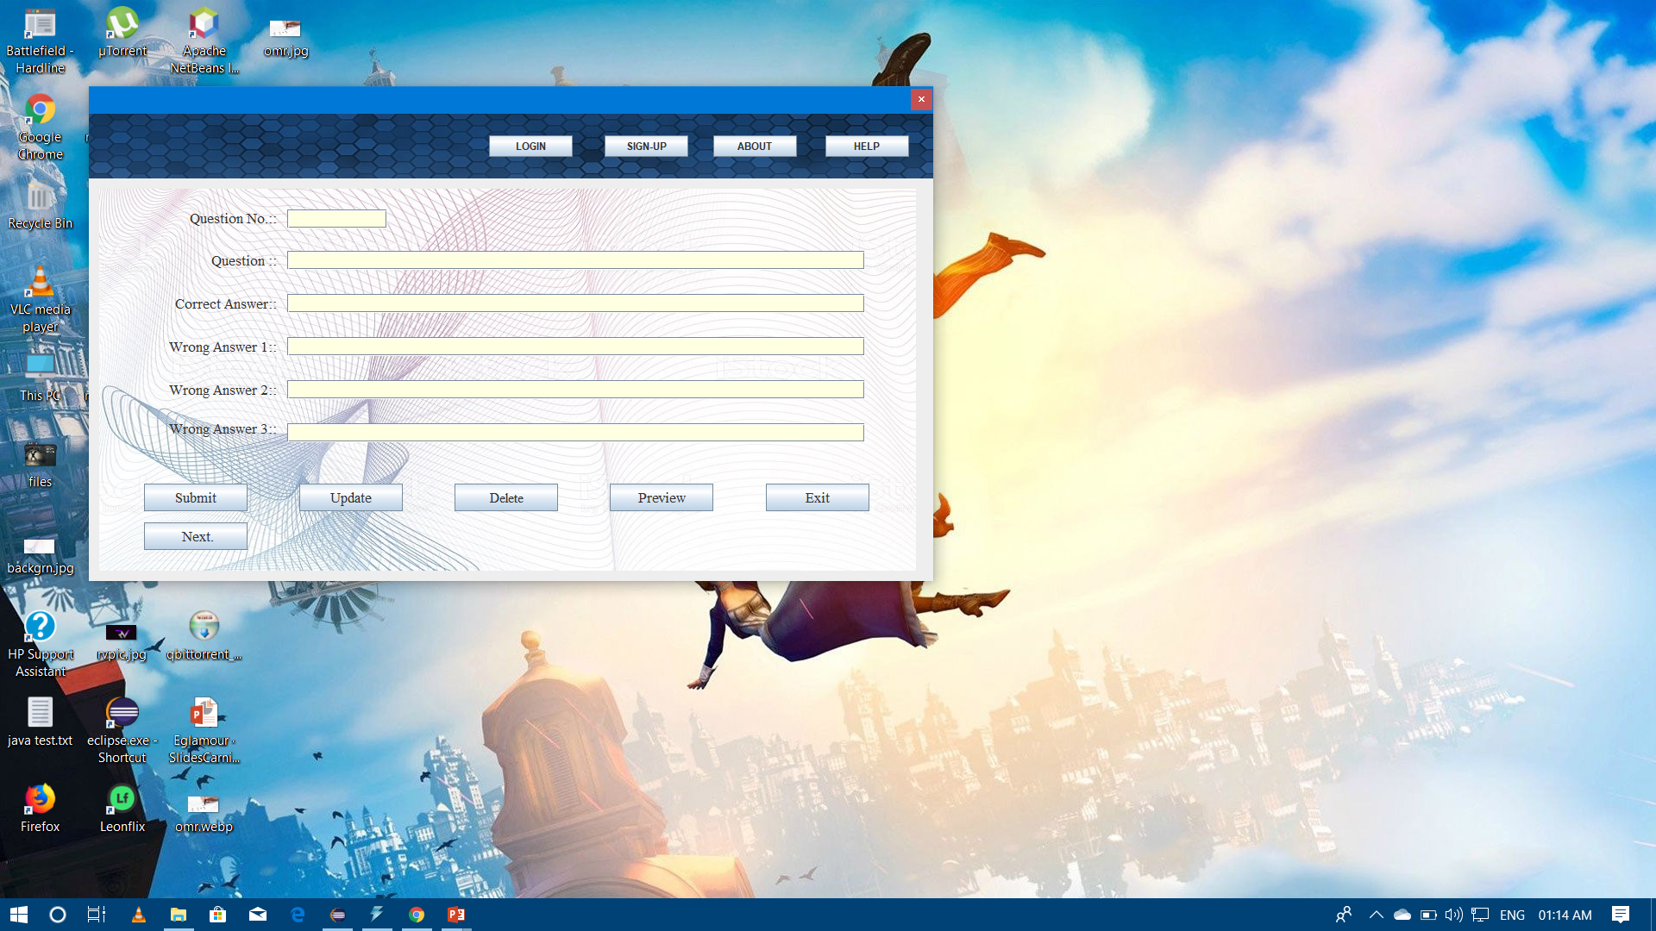
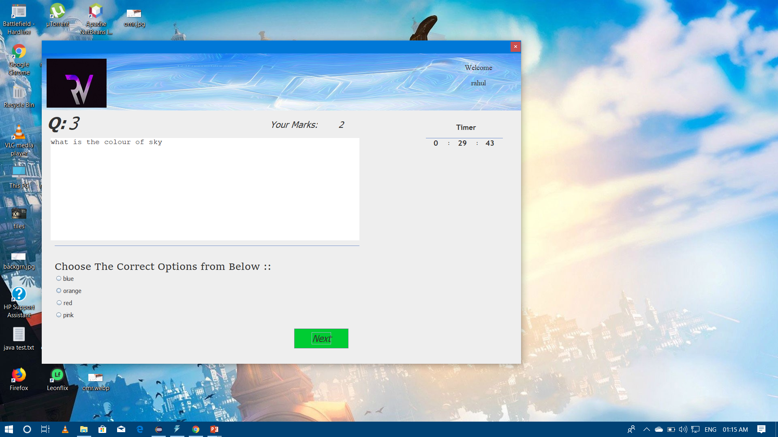
<Admin Panel> <Quiz Panel>

Slide 9
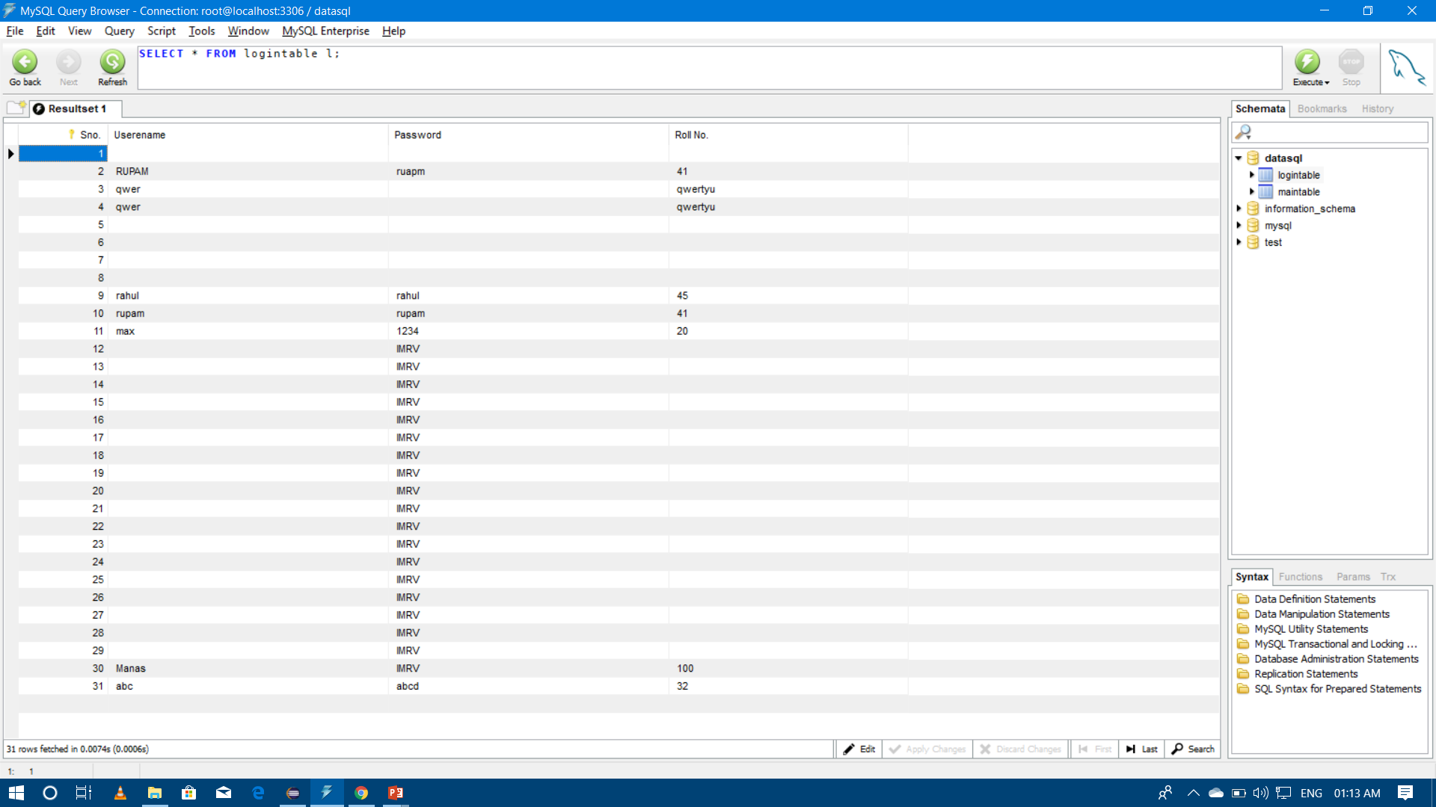
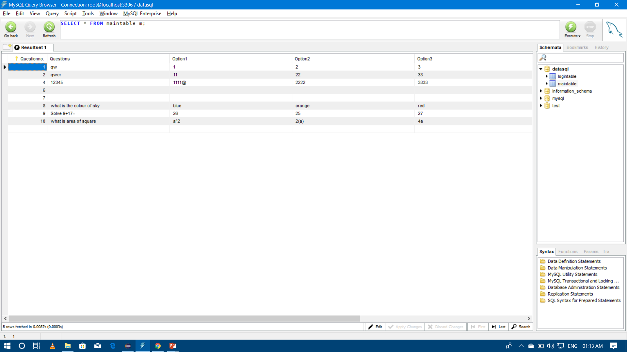
< DataBAse of Sign- up and Login >
<DATABASE FOR
QUESTION AND
ANSWERS OPTIONS>

Slide 10
Digitalising anything and Everything
These days are gone
Aren’t they

Slide 11
<Thanking you>
{Rahul Verma}
//digitalising anything and everything

